Slide 1
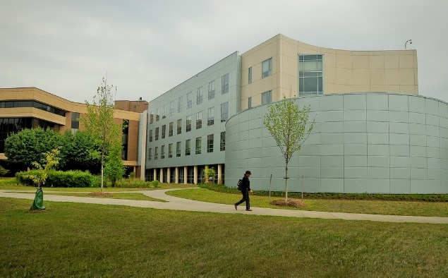
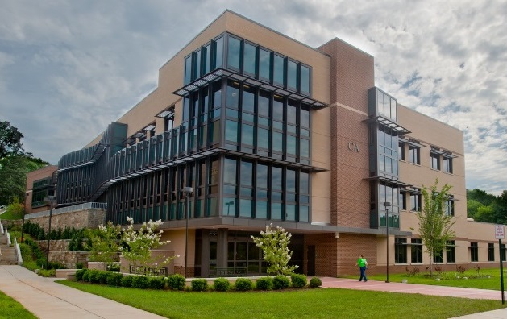
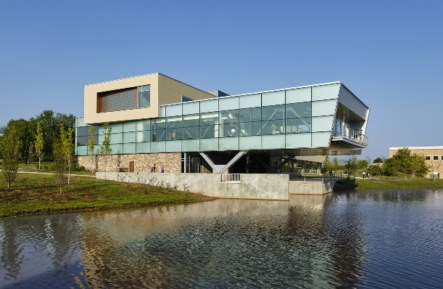
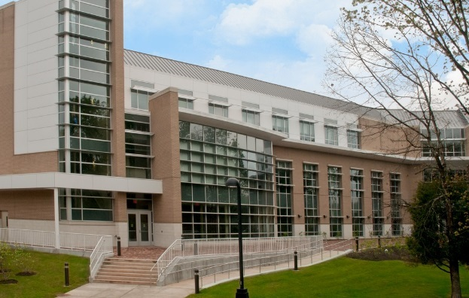
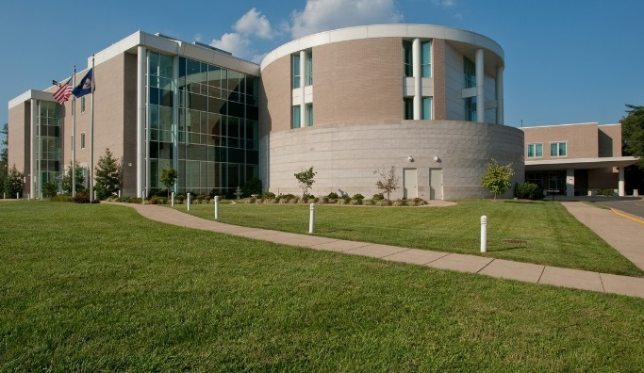
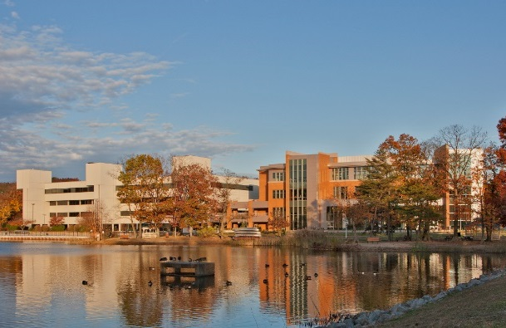
NORTHERN VIRGINIA COMMUNITY COLLEGE
OFFICE OF EMERGENCY MANAGEMENT AND SAFETY
Emergency Procedures at NOVA:
What Students Should Know
2020

Slide 2

Everyone has 10 minutes, right? In order to better prepare for an emergency, we ask each semester you take 10 minutes to:
2 minutes...
Sign up for NOVA Alert (alert.nvcc.edu). If you have already signed up, log in to make sure your most recent contact information is up to date.
8 minutes...
Go to nvcc.edu/emergency to review emergency procedures for events that may happen at NOVA.
To Prepare
Take 10 minutes to prepare by visiting: http://www.nvcc.edu/emergency

Slide 3
BE PREPARED!!!
  NOVA wants you to be safe on Campus -- there is always the chance that an emergency situation may occur. Therefore, NOVA wants you to be prepared. Please take time to review safety and emergency information that NOVA provides through various resources. Your safety could depend on your knowledge of this information.
  Emergency Phone Numbers:
  College Police: 703-764-5000 – it is recommended that you program this number in your cell phone.
  911

Slide 4
LiveSafe App
NOVA has launched a new mobile safety app called LiveSafe !! The LiveSafe app allows you to:
Report tips to or request emergency services anonymously from NOVA Police.
Send your location to NOVA Police.
Let friends or family monitor your movements, so you never have to walk alone.
Share your concerns and suggestions with NOVA Police.
Have critical safety information at your fingertips.
Getting the app is fast, easy and FREE!
  Visit the iTunes or Google Play Store and download the LiveSafe app (blue shield icon).
  Choose NOVA from the list of schools.
  Fill in your name and contact info, so we can reach you in the event of an emergency.
If you have any questions about LiveSafe, check out www.LiveSafeMobile.com or call NOVA Dispatch at 703-764-5000.

Slide 5

NOVA Safety Video
https://youtu.be/5spjbSSlLGk

Slide 6
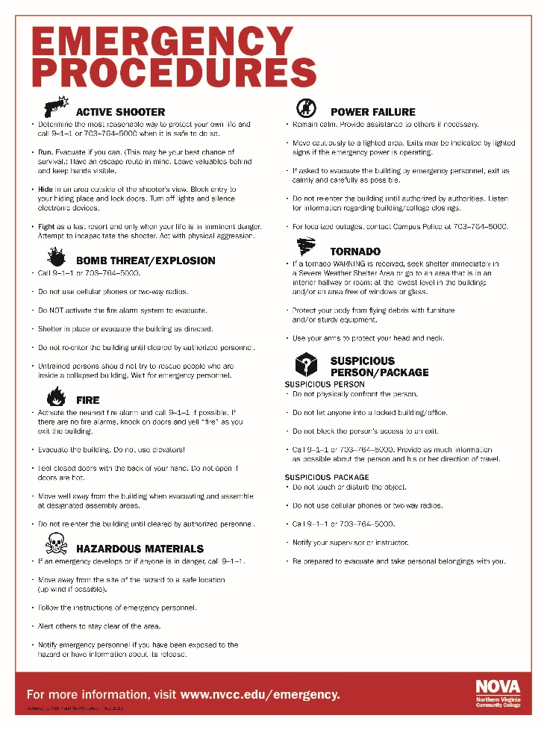
Emergency Procedures Posters
Emergency Procedures Posters are displayed throughout the Campus. Please take time to review the valuable information.

Slide 7
Emergency Preparedness
What You Should Know:
The two safest and most direct evacuation routes
Be familiar with your surroundings. Make sure you know the location of exits and the evacuation routes from your classrooms and other areas of the Campus.

Slide 8
Emergency Preparedness
What You Should Know:
The location of designated Assembly Areas outside of the facility
If evacuating the building for an emergency, you should always exit the building through the closest/safest exit, then proceed directly to the nearest Assembly Area.
Faculty and Staff will be directing you to these areas.
Once in the area, STAY THERE until you are dismissed.
These areas are a safe distance from the building and will keep you from obstructing First Responders. It is unlawful to obstruct First Responders.

Slide 9
Annandale Campus Assembly Areas
Highlighted areas are designated as assembly areas during evacuations.

Slide 10
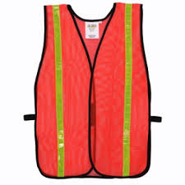
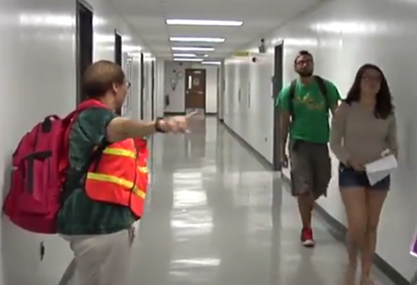
Warden Program
NOVA has established a Warden Program, consisting of Faculty and Staff, who assist with evacuation and coordination of people during emergencies.
In the event of an emergency situation, follow directions from Wardens, who will be wearing orange safety vests.

Slide 11
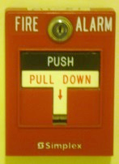
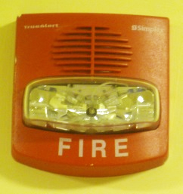
Fire
Activate the fire alarm.
Call 911 if possible.
Feel doors with the back of your hand before opening.
Do not use elevators.
Evacuate the building.
If time, conditions and safety permit, take your personal belongings with you.
Once outside, move away from the building and to a designated Assembly Area.
Do not re-enter buildings until instructed to do so.

Slide 12
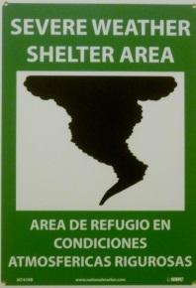
Tornado
If the area is under a Tornado WARNING, seek shelter immediately
to:
  The nearest Severe Weather Shelter Area
OR
  A hardened area that is in an interior hallway or room; free of windows or other glass structures; and at the lowest level in the building
Use stairs – NOT elevators – when seeking a shelter location.
Go to the center of the room, away from corners, doors and outside walls.
If possible, get under a sturdy table. Use your arms to protect your head and neck. Protect your body from flying debris with any available furniture or sturdy equipment.

Slide 13
Tornado
If you are outside with no shelter, there is no single research-based recommendation for what last-resort action to take because many factors can affect your decision.
Possible actions include:
Immediately get into a vehicle, buckle your seat belt and try to drive to the closest sturdy shelter. Ifyour vehicle is hit by flying debris while you are driving, pull over and park.
Take cover in a stationary vehicle. Put the seat belt on and cover your head with your arms and a blanket, coat or other cushion -if possible.
Lie in an area noticeably lower than the level of the roadway and cover your head with your arms and a blanket, coat or other cushion -if possible.
In all situations:
Do not get under an overpass or bridge. You are safer in a low, flat location.
Never try to outrun a tornado in urban or congested areas in a car or truck. Instead, leave the vehicle immediately for safe shelter.
Watch out for flying debris. Flying debris from tornadoes causes most fatalities and injuries.

Slide 14
Earthquake
If you are indoors, stay there until the shaking has stopped.
DROP to the floor.
COVER by getting under sturdy furniture
HOLD ON until the shaking stops.
Stay away from glass, windows, outside walls or doors, and anything that could fall on you.
If you are outdoors, move away from buildings, overhangs, trees, and/or power lines to a clear area.

Slide 15
Earthquake
Once the shaking has stopped:
Exit the building when safety permits and move to a designated Assembly Area.
Be aware that utilities such as gas, power, and water lines may be damaged.
Help injured persons.
Expect aftershocks.
Use the telephone only for emergency calls.

Slide 16
Power Failure/Outage
Remain calm.
Move cautiously to a lighted area.
Provide assistance to others.
Evacuate the building only if directed to do so.
Do not re-enter building until authorized.
Monitor NOVA Alert and Media Outlets for campus closings/updates.

Slide 17
Hazardous Materials
Move away from the site of the hazard to a safe location.
Call 911.
Follow instructions of Emergency Personnel.
Alert others to stay clear of the area.
Notify Emergency Personnel if you have been exposed to the hazard or have information about its release.

Slide 18
Reporting Dangerous Situations
You are required to notify the NOVA Police Department at 703-764-5000 of any situation or incident that involves a significant emergency or danger that may pose an immediate or on-going threat to the health and safety of students and/or employees on campus.
Help us keep your Campus SAFE!

Slide 19
Alert Technology at NOVA
NOVA Website
Classroom and Office Phones
NOVA Alert (Text Messages)
NOVA Desktop Computer Alerts (Pop-Ups)
Flat Panel TVs
College Email
NOVAaccess on Social Media
AM Radio 1630 Transmitter

Slide 20
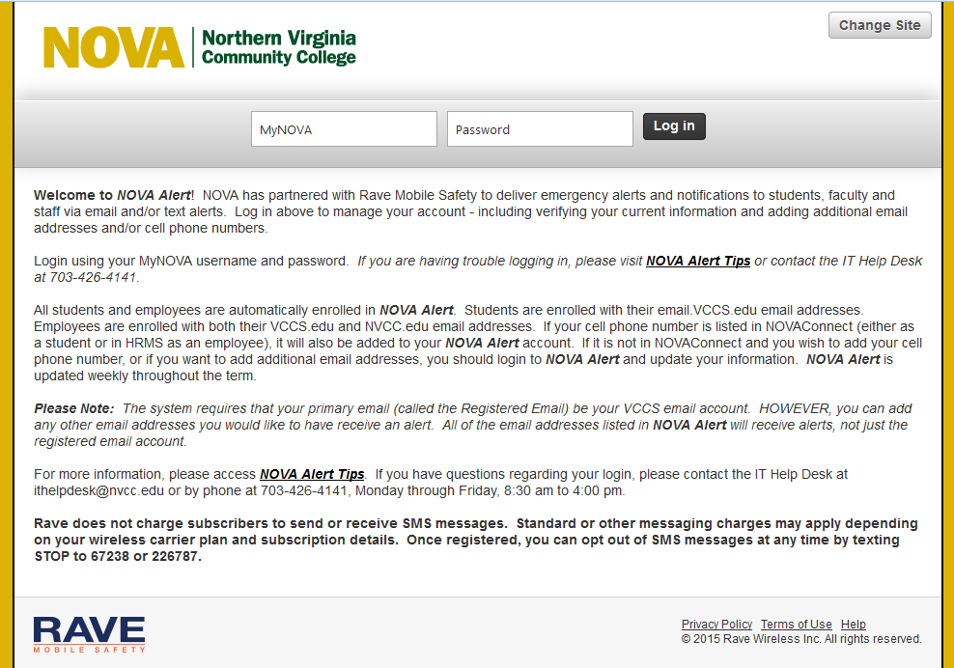
Have you signed up for NOVA Alert?
https://alert.nvcc.edu
Emergency Text Alerting System
Sign up today!
Important emergency information
College Closings/Delays
Communication tool

Slide 21
Drills
At a minimum, NOVA will conduct the following drills annually:
    Fire
    Earthquake
    Tornado
    Alert Notification
**If you are on Campus during a drill, NOVA requires you to participate.

Slide 22
Thank You!
NOVA and the Office of Emergency Management and Safety (OEMS) appreciate your effort in making this NOVA Campus a safe and rewarding place to attend school.
Should you desire further information on how to be prepared, please contact the Office of Emergency Management and Safety at OEM@nvcc.edu or visit the OEMS website at www.nvcc.edu/emergency. You can also view available resources from FEMA at www.ready.gov.
David Bellew
Emergency Management Coordinator
Office of Emergency Management and Safety
Northern Virginia Community College
571-314-4989
dbellew@nvcc.edu

Slide 23


